Slide 1

Beers of the USA
Group 1
Gabriel A.
Chad D.
Jeremy J.
Nick O.
Debra W.
“I DON’T ALWAYS DRINK BEER, BUT WHEN I DO, IT’S FROM THE USA”

Slide 2
OVERVIEW
Our dashboard focused on querying data from a brewery dataset (csv) so that users can query a name of beer using a drop down menu from beers/breweries within the US. Once the user has picked a beer, the dashboard visuals will change accordingly.
“I DON’T ALWAYS DRINK BEER, BUT WHEN I DO, IT’S NEVER AN IMPORT”

Slide 3

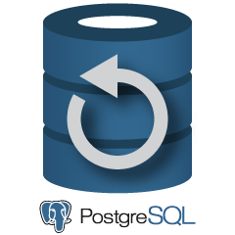


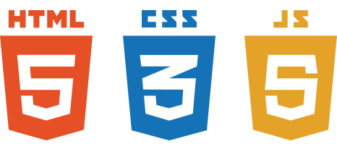


Workflow
Web visualization
- Flask
- Static html
SQL database in Postgre server.
Web application framework JSON API
Data manipulation, cleaning, and mining. Database connection.
CSV files located in the Data folder
Json API reader, Jquery, D3, Leaflet.

Slide 4
Steps to recreate
Clone the project repository to your computer.
Open a session in Postgre SQL and create a database titled “beersDB”.
Run the notebook “analysis.ipynb”, this will load csv into the different tables in the “beersDB”.
Start up the Flask application app.py and run inside the project folder in the command prompt
Open the site on localhost:5000 and enjoy.
Use the drop down menu to pick different beers and watch the dashboard change.
“I don’t always drink beer, but when I do, I need a flask”

Slide 5
Datasets USED
The data for this project was found from:
Nick Hould's Craft Cans
J. Trofe's Beer Recipes
Brett Kurzawa's US Breweries
Open Beer Database
“I don’t always Analyze beer, but when I do, I need a good dataset”

Slide 6
DATA & VIZ LIMITATIONS
Robust information
Style types
Breweries
Visualizations
“I don’t always drink beer, but when I do, I know my limits”

Slide 7
Dashboard Presentation
“I don’t always drink beer, but when I do, I need a dash of lime”

